Slide 1
WELCOME TO ORIENTATION 2024-2025 CENTRAL TEXAS BIBLE COLLEGE
PRESIDENT:
APOSTLE HENRY ANDRUS
VICE-PRESIDENT:
PASTOR BRENDA ANDRUS
DEAN OF STUDENTS:
LARONNIA GRAY
REGISTRAR:
DEBBIE BARLOW
BOARD MEMBERS:
SANDRA LIMBRICK
DR. CLEMENTINE KING

Slide 2
TABLE OF CONTENTS
WELCOME
INTRODUCTION/SCHOOL INFORMATION
SCHOOL ACCREDITATION CERTIFICATE
AFFILIATED BIBLE COLLEGES
STAFF MEMBERS
CLASS INSTRUCTORS/ CLASS COLORS
OUR MISSION STATEMENT
DOCTRINAL STATEMENT
CURRICULUM
COURSE FEES/MATERIALS
CLASS SCHEDULES/TIMES
FINANCIAL AGREEMENTS
RULES AND REGULATIONS

Slide 3
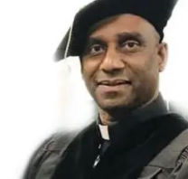
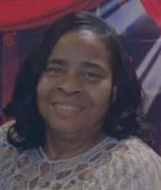
A SPECIAL WELCOME CENTRAL TEXAS BIBLE COLLEGE PRESIDENT VICE-PRESIDENT
Apostle Henry W. Andrus
Pastor Brenda D. Andrus
WELCOME TO CENTRAL TEXAS BIBLE COLLEGE WE ARE HONORED TO HAVE EACH AND EVERY ONE OF YOU.
THANKS FOR CHOOSING TO EXPLORE CENTRAL TEXAS BIBLE COLLEGE WE STRIVE TO HELP EMPOWER YOU WITH THE WORD OF GOD BY TEACHING YOU THE BASIC PRINCIPLE AND KNOWLEDGE OF THE WORD OF GOD.
OUR FACULTY MEMBERS’ ACADEMIC AND MINISTRY EXPERIENCES ENHANCE THEIR ABIBITY TO TEACH THE UNADULTRATED WORD OF GOD WITH WISDOM AND POWER BY THE HOLY SPIRIT; WHICH ENHANCE THEIR ABILITY TO TEACH WITH EXPERTISE AND MENTOR WITH UNDERSTANDING.

Slide 4
INTRODUCTION
CENTRAL TEXAS BIBLE COLLEGE WAS ESTABLISHED IN 2013.
THE PRESIDENT IS APOSTLE HENRY W. ANDRUS
LOCALLY OWNED AND OPERATED IN JASPER, TEXAS.
569 EAST GIBSON
JASPER, TX 75951
(337)375-2897

Slide 5
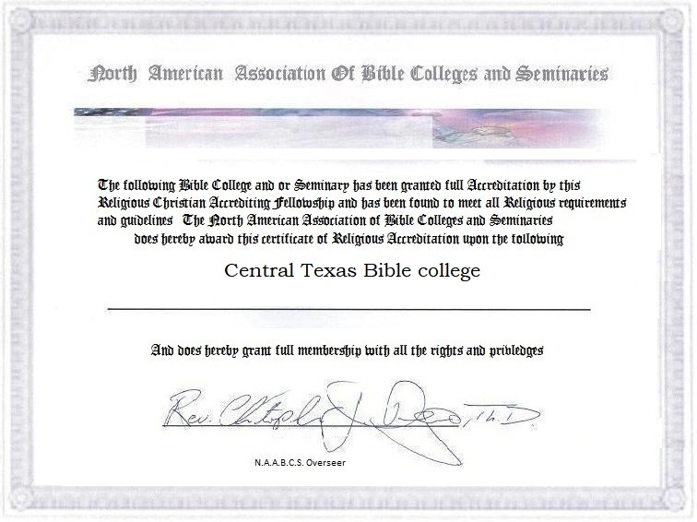
CENTRAL TEXAS BIBLE COLLEGE ACCREDITATION

Slide 6
AFFILIATED BIBLE COLLEGES
HARVESTIME INTERNATIONAL NETWORK

Slide 7
STAFF MEMBERS
PREDSIDENT: APOSTLE HENRY ANDRUS (337)375-2897
EMAIL: bishophopj@gmail.com
VICE-PRESIDENT: PASTOR BRENDA ANDRUS (337)396-4009
EMAIL: pinkoneboy@yahoo.com
INSTRUCTORS:
DORCENIA SIMON (409)293-1102
LARONNIA GRAY (409)594-4176
JENNIFER LINCOLN (409)202-1189
DEBBIE BARLOW (409)594-3335
LOLA SIMMONS (409)594-5205
INA MARTIN (409)550-0926

Slide 8
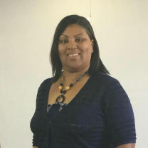
ASSOCIATE CLASS INSTRUCTORS CLASS COLOR: GRASS GREEN
INA MARTIN
(409)550-0926
msinadean@aol.com

Slide 9
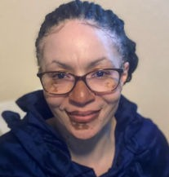
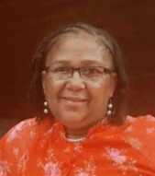
BACHELOR CLASS INSTRUCTORS CLASS COLOR: GOLD
LARONNIA GRAY
Dean of Students
(409)594-4176
laronniag@gmail.com
JENNIFER LINCOLN
(409)202-1189
lastdaywarning@gmail.com

Slide 10
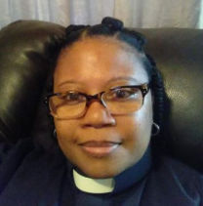
MASTER CLASS INSTRUCTOR CLASS COLOR: BLUE
DORCENIA SIMON
(409)293-1102
dorceniafrank@yahoo.com

Slide 11
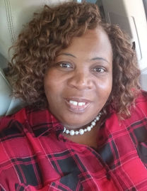
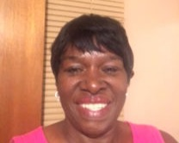
DOCTORATE CLASS INSTRUCTOR CLASS COLOR: RED
DEBBIE BARLOW
REGISTRAR
(409)594-3335
debbiebarlow945@yahoo.com
LOLA SIMMONS
(409)594-5205
is_54jetbrown@yahoo.com

Slide 12
OUR MISSION STATEMENT
TO MOBILIZE, TO TEACH , AND TO TRAIN DISCIPLES THE UNADULTERATED WORD OF GOD TO RIGHTLY DIVIDE THE WORD OF TRUTH TO GO ABROAD INTO ALL THE WORLD AS WITNESSES.
MATT 28:19
GO YE THEREFORE, AND TEACH ALL NATIONS, BAPTIZING THEM IN THE NAME OF THE FATHER, AND OF THE SON, AND OF THE HOLY GHOST.

Slide 13
DOCTRINAL STATEMENT
2 TIM 2:15
STUDY TO SHEW THYSELF APPROVED UNTO GOD, A WORKMAN THAT NEEDETH NOT TO BE ASHAMED, RIGHTLY DIVING THE WORD OF TRUTH.

Slide 14
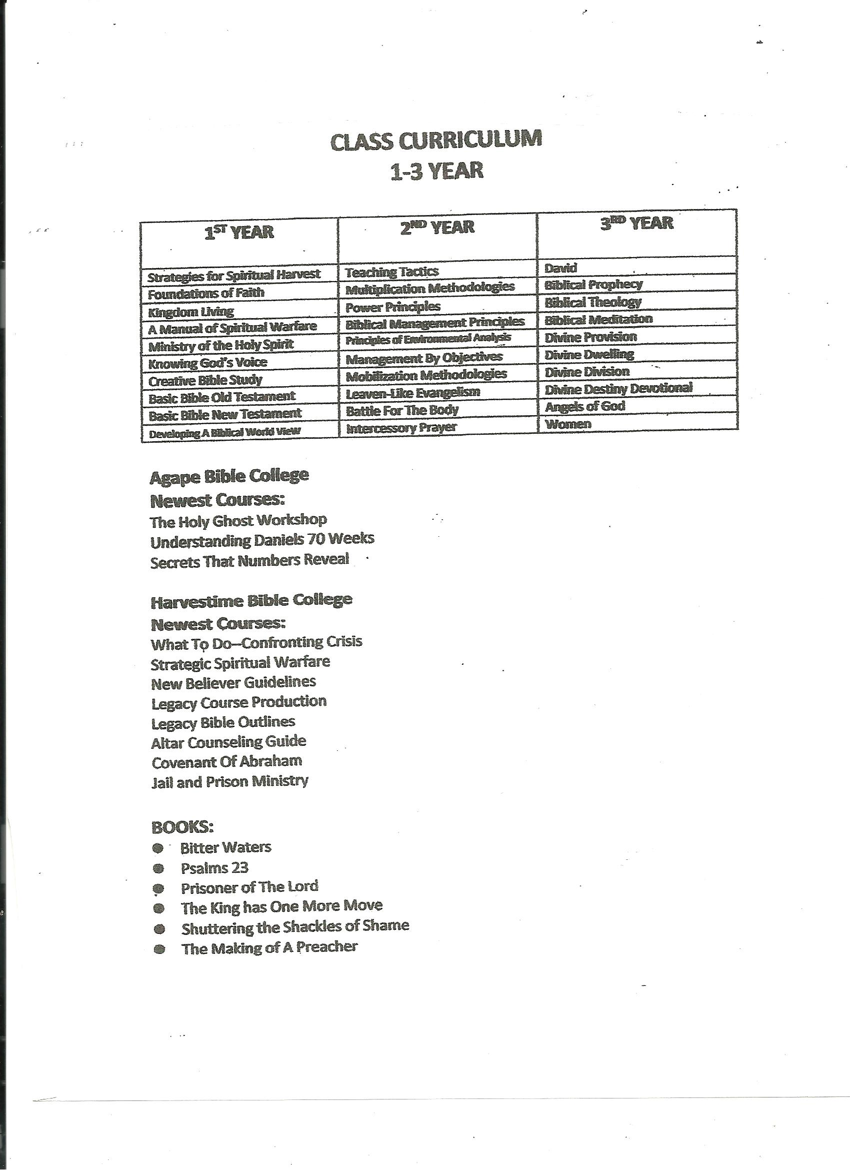

Slide 15
CLASS CURRICULUM
CLASS#1 STRATEGIES FOR SPIRITUAL HARVEST
CLASS#2 FOUNDATIONS OF FAITH
CLASS#3 KINDOM LIVING
CLASS#4 SPIRITUAL STRATEGIES: A MANUAL OF SPIRITUAL WELFARE
CLASS#5 MINISTRY OF THE HOLY SPIRIT
CLASS#6 KNOWING GOD'S VOICE
CLASS#7 CLASS#7 CREATIVE BIBLE STUDY METHODS
CLASS#8 BASIC BIBLE SURVEY
CLASS#9 DEVELOPING A BIBICAL WORLD VIEW
CLASS#10 TEACHING TACTICS
CLASS#11 MULTIPLICATION METHODOLOGIES
CLASS#12 POWER PRINCIPLES

Slide 16
CLASS CURRICULUM
CLASS#13 BIBLICAL MANAGEMENT PRINCIPLES
CLASS#14 PRINCIPLES OF ENVIRONMENTAL ANALYSIS
CLASS#15 MANAGEMENT BY OBJECTIVES
CLASS#16 MOBILZATION METHODOLOGIES
CLASS#17 LEAVEN-LIKE EVANGELISM
CLASS#18 BATTLE FOR THE BODY
CLASS#19 INTERCESSORY PRAYER
CLASS#20 DAVID
CLASS#21 BIBLICAL PROPHECY
CLASS#22 BIBLICAL THEOLOGY
CLASS#23 BIBLICAL MEDITATION
CLASS#24 DIVINE PROVISION
CLASS#25 DIVINE DWELLING

Slide 17
CLASS CURRICULUM
CLASS#26 DIVINE DIVISION
CLASS#27 DIVINE DESTINY DEVOTIONAL
CLASS#28 ANGELS OF GOD
CLASS#29 WOMEN
CLASS#30 JAIL AND PRISON MINISTRY
CLASS#31 WHAT TO DO—CONFRONTING CRISIS
CLASS#32 COVENANT OF ABRAHAM
CLASS 601 GREEK & HEBREW WORDS
CLASS 602 ALTAR COUNSELORS
CLASS 603 DOCTRINE & THEOLOGY
CLASS 604 VOCABULARY
CLASS 605 ADVANCE STUDY VARIOUS LESSONS

Slide 18
BOOKS:
THE MAKING OF A PREACHER
BITTER WATERS
PSALMS 23
PRISONER OF THE LORD
THE KING HAS ONE MORE MOVE
SHUTTERING THE SHACKLES OF SHAME

Slide 19
BIBLICAL DEGREE
ATTAIN ASSOCIATE DEGREE
ONE YEAR TERM
10 CLASS (60 CREDITS)
1 BOOK
ATTAIN A BACHELOR DEGREE
TWO YEAR TERM
10 CLASS (60 CREDITS)
2 BOOKS
ATTAIN A MASTERS DEGREE
THREE YEAR TERM
10 CLASS (60 CREDITS)
2 BOOKS

Slide 20
QUALIFICATIONS TO ATTAIN DOCTORATE DEGREE
BIBLICAL STUDIES
To attain a Doctorate Degree in Biblical Studies student, have a Master’s degree ( See Administration Department)
Student must have completed 5 courses
TWO Book Report (5 pages including cover page)
Student must complete 25-page Thesis
Student MUST take all test and turn in all class assignments.
Student MUST take the courses below:
DOCTORATE COURSES
601 Greek and Hebrew Words
602 Altar Counselors
603 Doctrine & Theology
604 Vocabulary
605 Advance Study(Different Lessons)
BOOKS:
Bitter Waters
Names of God
THESIS: HEBREW VERSES CHRISTAINITY
25 Page Thesis in lines of Biblical Theology (Bible)

Slide 21
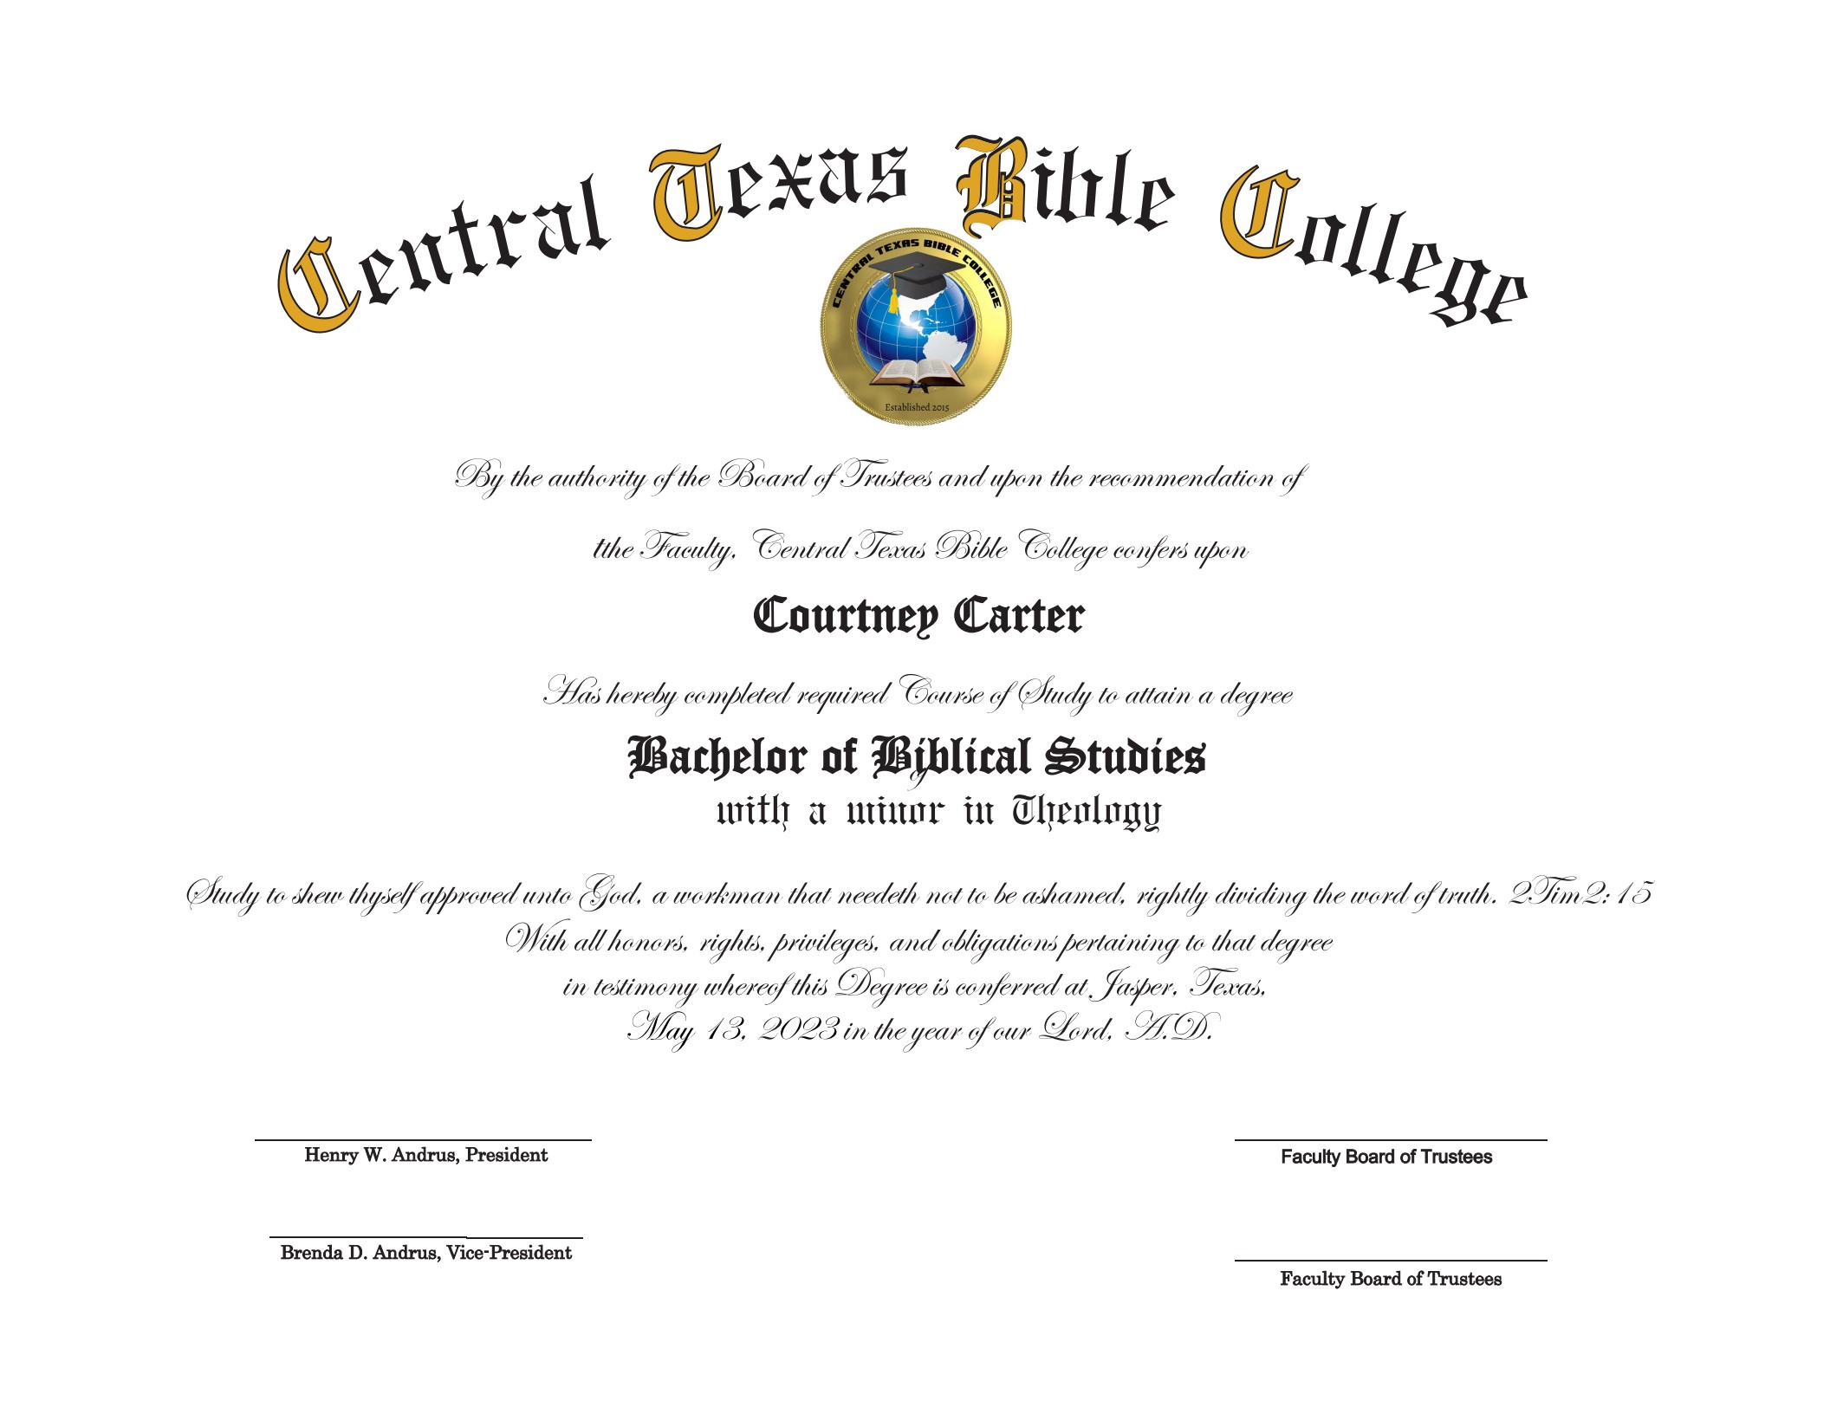

Slide 22
CERTIFICATES
STUDENTS CAN OBTAIN CERTIFICATES
WITH 5 CREDIT CLASSES
WE OFFER THEOLOGY CLASSES
EXTRA CREDIT COURSES
REFRESHER COURSES
FOR MORE INFORMATION, PLEASE CONTACT THE ADMINISTRATION DEPARTMENT

Slide 23
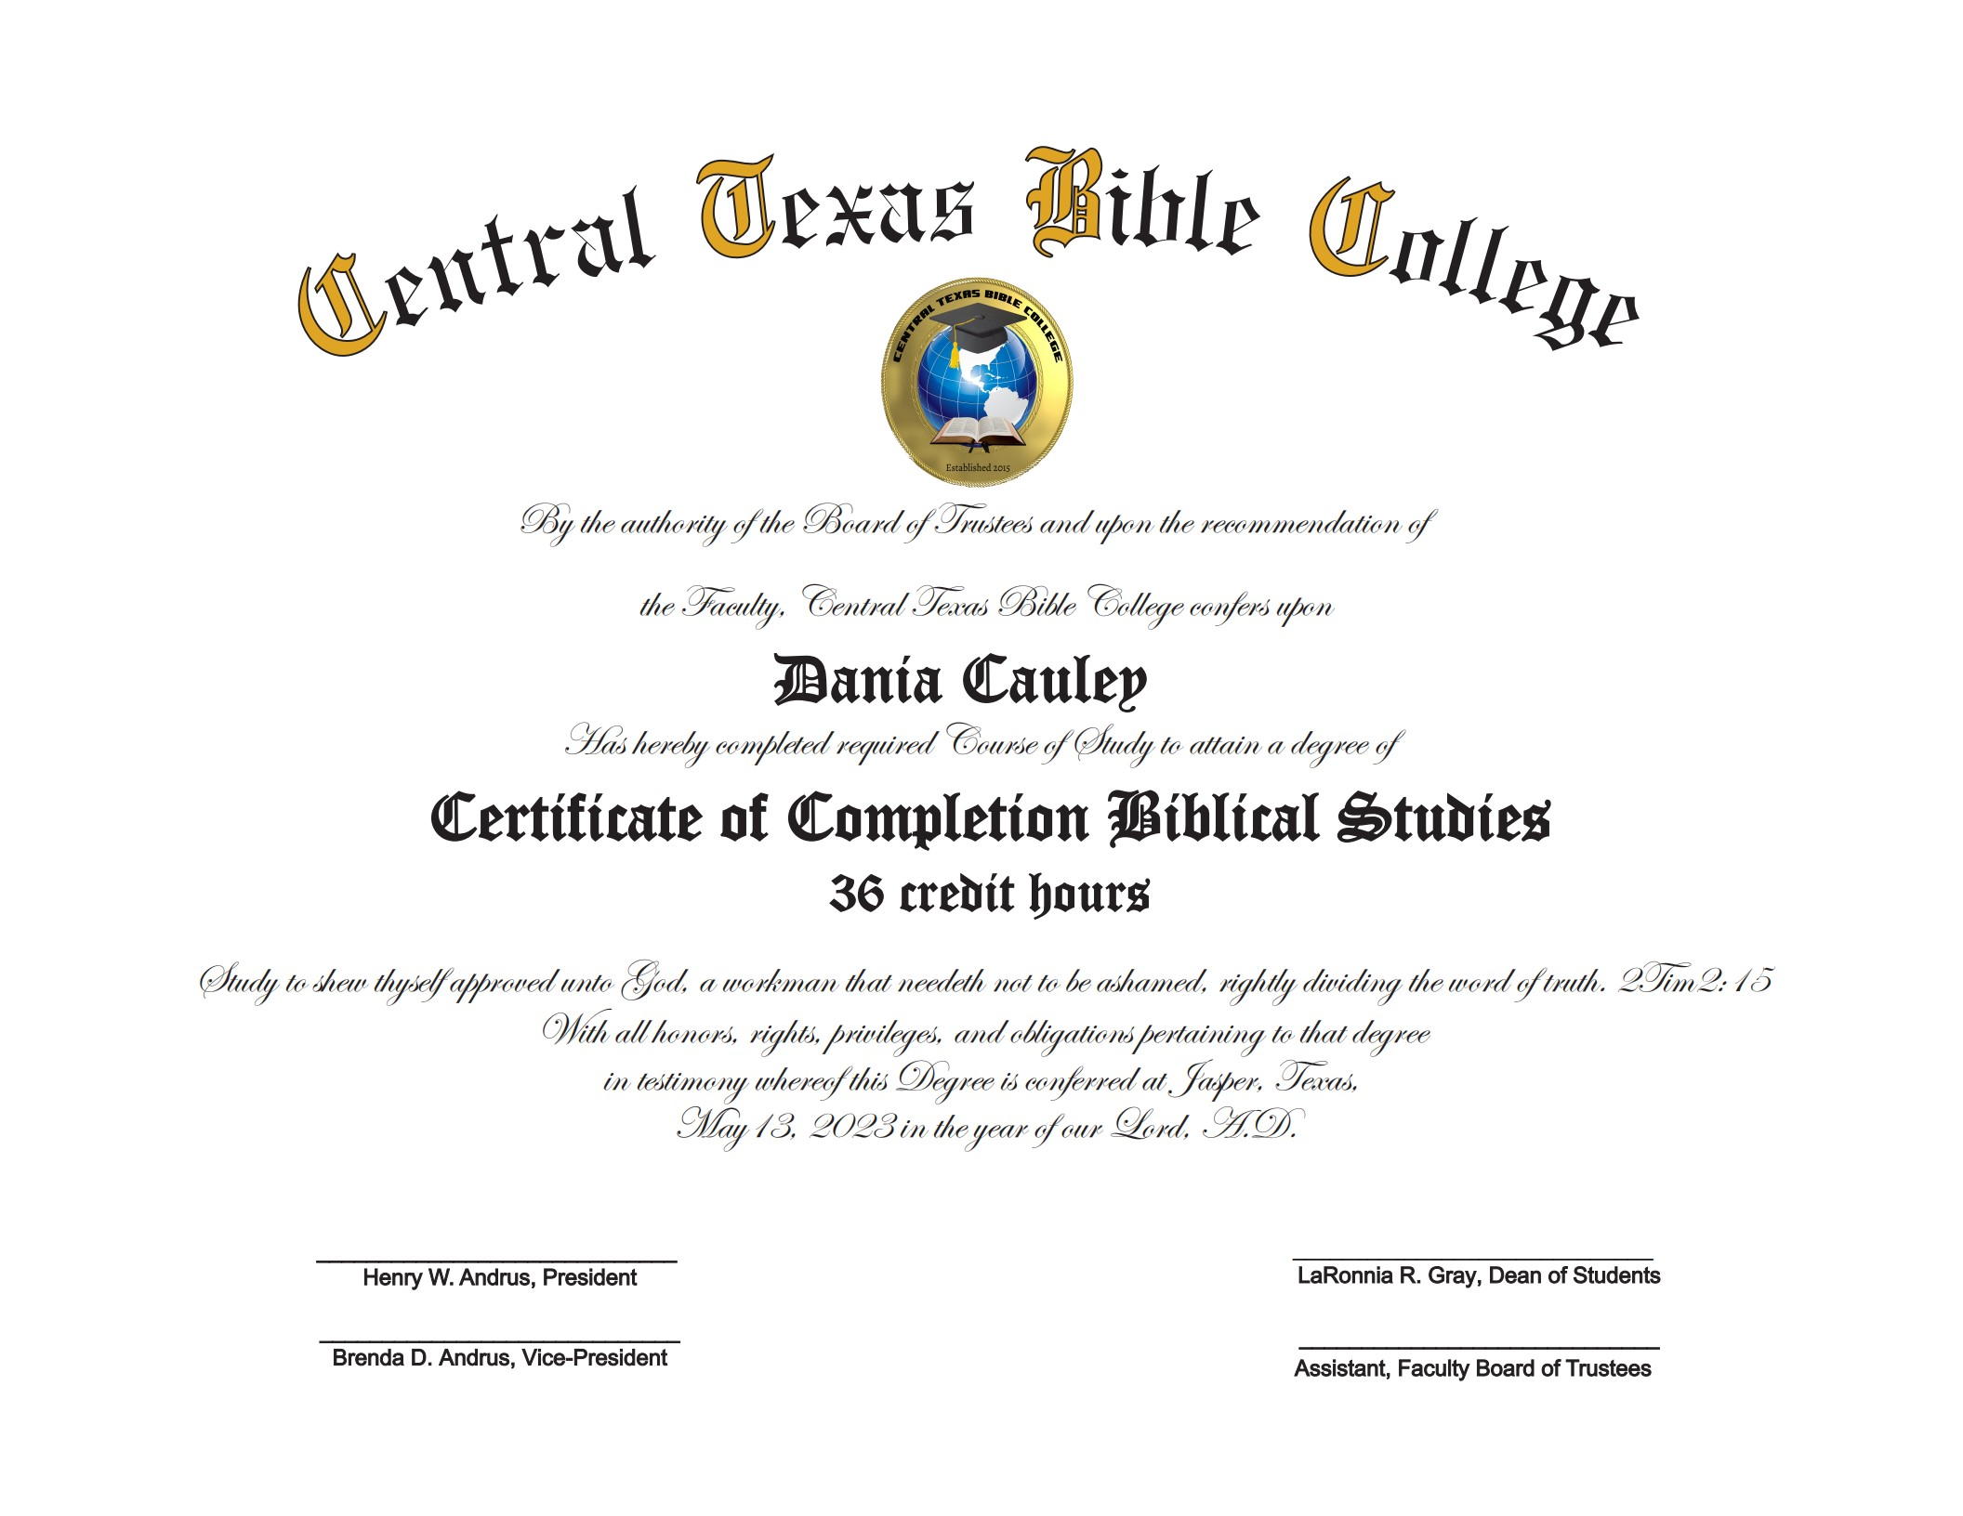

Slide 24
COURSE FEES & MATERIALS
CLASS FEE $700 (INCLUDES CAP & GOWN)
NEED KJV BIBLE
PEN & PAPER
ACCESS TO COMPUTER OR DEVICE

Slide 25
CLASS SCHEDULES/TIMES
FIRST CLASS BEGIN AUGUST 27, 2024
REGISTRATION HAS BEGUN
CLASSES WILL BE ON EVERY
TUESDAY & THURSDAY
6:30 P.M. UNTIL 8:30 P.M.
***PLEASE REPORT ALL TARDIES AND ABSENCES
TO YOUR INSTRUCTOR(S) PROMPTLY!

Slide 26
FINANCIAL AGREEMENTS
PLEASE NOTE THAT ANY AND ALL MONIES ARE DUE AS AGREED AND MUST BE PAID ACCORDINGLY.
MONTHLY INSTALLMENTS ARE DUE ON (OR) BEFORE THE
15TH OF EACH MONTH! CASHAPP: $CTBCJasper
MONTHLY: $50.00 QUARTERLY: $150.00 ANNUAL: $700
IF YOU HAVE ANY QUESTIONS OR CONCERNS, PLEASE CONTACT OUR ADMINISTRATION DEPARTMENT.
LaRonnia Gray (409)594-4176
Debbie Barlow (409)594-3335
Apostle Henry Andrus (337)375-2897
THANK YOU!!

Slide 27
RULES AND REGULATIONS
ALL STUDENT ARE REQUIRED TO ATTEND CLASS EACH DAY
STUDENTS ARE REQUIRED TO SHOW THEIR FACE DURING ZOOM CLASSES/ UNLESS APPROVED BY INSTRUCTOR
PLEASE NOTIFY YOUR INSTRUCTOR IF YOU'RE GOING TO BE LATE OR ABSENT FROM CLASS.
THERE IS A 10% GRADE PENALTY FOR ALL UNEXCUSED ABSENT(S)
STUDENTS ARE RESPONSIBLE FOR ALL LESSON & ASSIGNMENTS THAT ARE DUE. THERE IS A 10% GRADE PENALTY FOR ALL LATE ASSIGNMENTS.
PLEASE CONTACT THE ADMINISTRATION DEPARTMENT IF YOU NEED FURTHER QUESTIONS/ASSISTANCE.
THANK YOU, GOD BLESS,!

